Slide 1
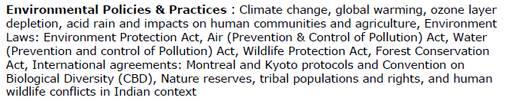
Unit 5

Slide 2

Greenhouse Effect and Global Warming
Weather
Weather is the condition of the atmosphere at a particular place and time
Climate
Climate change refers to the variation in Earth's global climate
or in regional climates over time.
The term greenhouse effect is used to indicate a heat-trapping process caused by gases such as carbon dioxide, and water vapour which are transparent to incoming solar radiations but re-emit the infrared radiations from Earth's surface
Global warming is a long-term rise in the average temperature of Earth as a whole as a result of greenhouse effect.
.

Slide 3
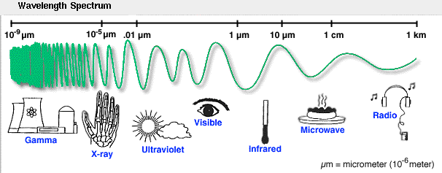
Electromagnetic Spectrum
incoming
outgoing

Slide 4
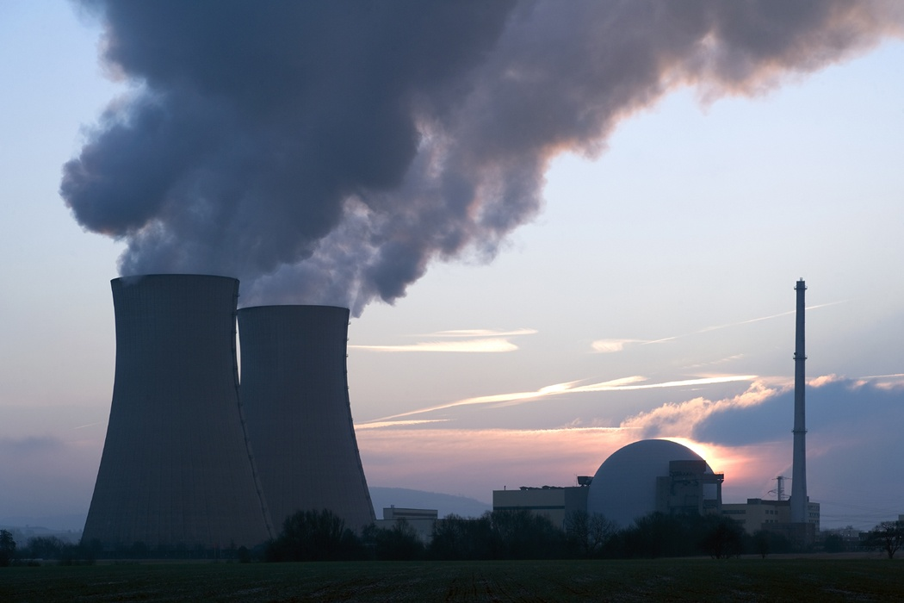
Greenhouses Gases
Carbon dioxide
Methane
Nitrous oxide
Chlorofluoro carbons

Slide 5
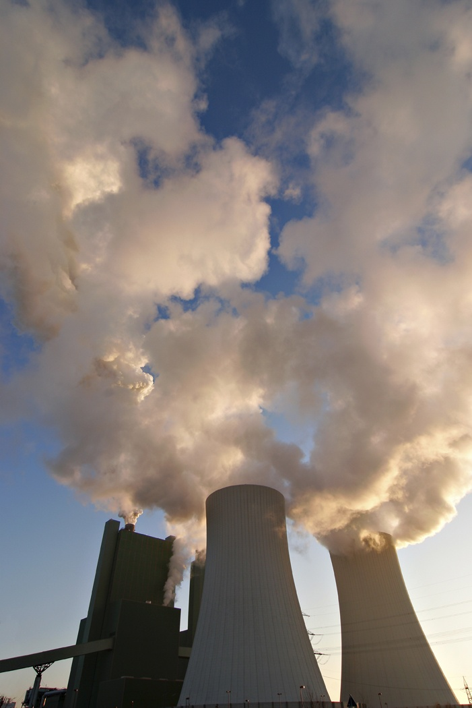
Activities Responsible for Emission of Greenhouse Gases
Fossil-fuel burning
Industrial processes
Deforestation
Livestock
Biomass burning
Coal mining

Slide 6
Effects of CO₂ increase
Air and the Earth’s surface may grow warmer.
The stratosphere may become cooler.
Temperate and polar regions may become warmer leading to the reduction in the ice cover of the earth.
Rainfall may be higher than what it is present in the temperate regions.
The greater amount of evaporation due to excess warmth .

Slide 7
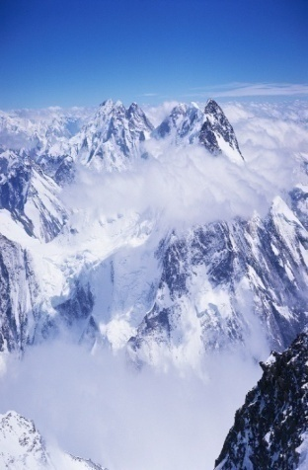
Environmental Effects of Global warming
Climate change
Rise in sea level
Agricultural production
Storms
Adverse effects on human health
Loss of ecosystems and biodiversity

Slide 8
Control measures
Reduction in the use of fossil fuels
Shifting to the renewable energy sources that do not emit greenhouse gases
Increasing the use of energy efficient and cleaner production technologies and practices
Reducing deforestation, adopting better forest management practices, and undertaking aforestation to sequester carbon

Slide 9
Acid Rain
Acid rain refers to a condition in which natural precipitation becomes acidic after reacting chemically with pollutants in the air.
Causes of Acid Rain
Burning of the fuel as well as the use of nuclear weapons leading to the evolution of large amounts of sulphur dioxide (SO₂) and nitrogen dioxide (NO₂), which get converted to sulphurous acid and nitric acid, respectively.

Slide 10
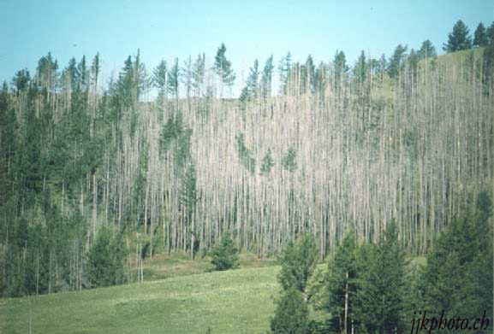
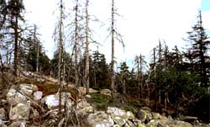
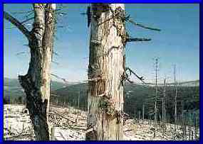
Forests affected by Acid Rain
Northeast US
Canada
Northern Europe
Asia

Slide 11
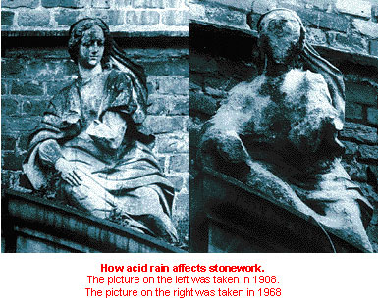
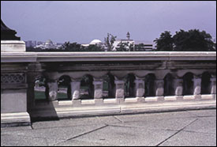

Slide 12

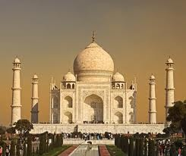

Effects of Acid Rain
Accelerates weathering in metal and stone structures
  Eg. Parthenon in Athens, Greece; Taj Mahal in Agra, India
http://www.lauraknauth.com/photos/france/thinker.jpg

Slide 13
Adverse Effects of Acid Rain
Reduction in population of aquatic biota
Damage to terrestrial ecosystems
Corrosion of buildings
Effect on human beings

Slide 14
Ozone Layer and Its Depletion
The decrease in the concentration of ozone (O₃) in stratosphere is known as
ozone layer depletion.
Chief Cause
Widespread use of chlorofluorocarbons (CFCs)

Slide 15
CFCs
CFCs are powerful O₃ destroyers. They are used in the following ways:
As coolants in the compressors of refrigerators and air conditioners.
To clean electronic circuit boards used in computers, telephones, etc.
In the manufacture of foams for mattresses and cushions, disposable styrofoam cups, packaging material, cold storage, etc.
Ozone Hole
The thinning of ozone layer or reduction in concentration of ozone especially over the area of Antarctic continent is known as ozone hole, which covers approximately seven million square kilometer.

Slide 16







Mechanism of Ozone Layer Depletion
a)
b)
c)
d)
e)

Slide 17
Environmental Effects of O₃ Layer Depletion
Damage to land plants
Decrease in population of aquatic community
Increase in the rate of skin diseases and cancers in human beings
Disturbance in climate patterns
Corrosion of materials
Control Measures
Evolving substitutes for CFCs
Development of hydrochloroflourocarbons and hydrofluorocarbons

Slide 18
Related links
1. Climate change
https://www.carbonbrief.org/10-of-the-best-youtube-videos-on-climate-change
2. global warming
http://video.nationalgeographic.com/video/101-videos/global-warming-101
http://www.howglobalwarmingworks.org/in-under-4-minutes-ba.html
3. ozone layer depletion
https://www.youtube.com/watch?v=PXV6ppONgUk
4. acid rain and impacts on human communities and agriculture
https://www.youtube.com/watch?v=9aEx067YkDE
https://www.youtube.com/watch?v=893KB3s_jIA
http://study.com/academy/lesson/acid-rain-effects-causes-quiz.htm

Slide 19
1. Which of the following is not the mission of India’s National Action Plan on Climate Change?
A. National solar mission
B. National water mission
C. National Mission for a Green India
D. National Mission on Sustainable Development
2. Which Ministry has undertaken the National Mission for a “Green India?
A. Ministry of Rural Development
B. Ministry of Environment & Forest
C. Ministry of Earth Affaris
D. None of these

Slide 20
1. Which of the following is not the mission of India’s National Action Plan on Climate Change?
A. National solar mission
B. National water mission
C. National Mission for a Green India
D. National Mission on Sustainable Development
Ans: D
2. Which Ministry has undertaken the National Mission for a “Green India?
A. Ministry of Rural Development
B. Ministry of Environment & Forest
C. Ministry of Earth Affaris
D. None of these
Ans: B

Slide 21
3. Which statement/s is/are true about National Solar Mission?
I. A goal of increasing production of Photovoltaics to 1000 MW/year.
II. Increase the use of solar thermal technologies in urban areas, industry, and commercial establishments.
III. A goal of deploying at least 1500 MW of solar thermal power generation.
A. Only I, II
B. Only II, III
C. All
D. None of these

Slide 22
3. Which statement/s is/are true about National Solar Mission?
I. A goal of increasing production of Photovoltaics to 1000 MW/year.
II. Increase the use of solar thermal technologies in urban areas, industry, and commercial establishments.
III. A goal of deploying at least 1500 MW of solar thermal power generation.
A. Only I, II
B. Only II, III
C. All
D. None of these
Ans: A

Slide 23
4.The United Nations Framework Convention on Climate Change (UNFCCC or FCCC) is also known as:
A. Kyoto protocol
B. Vienna convention
C. Earth summit
D. None of these
5.The United Nations Framework Convention on Climate Change (UNFCCC or FCCC) is held in:
A. 1992
B. 1995
C. 1989
D. 1990
6.The basic objectives of The United Nations Framework Convention on Climate Change (UNFCCC or FCCC) is:
A. To stabilize the melting ice of Antarctic Ocean
B. To "stabilize greenhouse gas concentrations in the atmosphere at a level that
would prevent dangerous anthropogenic interference with the climate system."
C. Reduce the carbon emission upto the level of 1992
D. Stabilize the ozone layer depletion.

Slide 24
4.The United Nations Framework Convention on Climate Change (UNFCCC or FCCC) is also known as:
A. Kyoto protocol
B. Vienna convention
C. Earth summit
D. None of these
5.The United Nations Framework Convention on Climate Change (UNFCCC or FCCC) is held in:
A. 1992
B. 1995
C. 1989
D. 1990
6.The basic objectives of The United Nations Framework Convention on Climate Change (UNFCCC or FCCC) is:
A. To stabilize the melting ice of Antarctic Ocean
B. To "stabilize greenhouse gas concentrations in the atmosphere at a level that
would prevent dangerous anthropogenic interference with the climate system."
C. Reduce the carbon emission upto the level of 1992
D. Stabilize the ozone layer depletion.

Slide 25
7.When & where was the first UNFCCC Conference of Parties (COP) took place?
A. April 1995 in Berlin, Germany
B. June 1992 in Paris, France
C. August 1997 in Kyoto, Japan
D. Dec 1995 in Zeneva, Switzerland
8.Where was the last conference of parties (COP) held?
A. Copenhagen
B. Lima
C. Poland
D. Brussels
9.When was India’s first National Action Plan on Climate Change (NAPCC) launched?
A. 2010
B. 2008
C. 2001
D. 2006
10.Till date how many conference of parties (COPs) have taken place?
A. 22
B. 23
C. 24
D. 25

Slide 26
7.When & where was the first UNFCCC Conference of Parties (COP) took place?
A. April 1995 in Berlin, Germany
B. June 1992 in Paris, France
C. August 1997 in Kyoto, Japan
D. Dec 1995 in Zeneva, Switzerland
8.Where was the last conference of parties (COP) held?
A. Copenhagen
B. Lima
C. Poland
D. Brussels
9.When was India’s first National Action Plan on Climate Change (NAPCC) launched?
A. 2010
B. 2008
C. 2001
D. 2006
10.Till date how many conference of parties (COPs) have taken place?
A. 22
B. 23
C. 24
D. 25

Slide 27
14. Find the correct statement
(a) The waste from one process becomes the input for another process
(b) All the processes related to consumption and production produce some kind of waste
(c) There is no real waste in nature
(d) All of the above
15. Which of the following methods is better for the solid waste problem?
(a) Recycling
(b) Landfilling
(c) Both a and b
(d) None of the above
16. Which of the following statements is incorrect for plastic wastes?
(a) It is used to make compost
(b) It lasts for a longer period of time
(c) Toxic fumes are produced when burnt
(d) All of the above
17. Which of the following can be recycled many times?
(a) Wood
(b) Plastic
(c) Aluminium
(d) Organic materials
18. Which of the following gas is produced from landfill wastes?
(a) Biogas
(b) Natural gas
(c) Liquified petroleum gas
(d) All of the above
19. Which of the following statements is true about zero waste management?
(a) Separate collection of each kind of waste
(b) Segregation of garbage at the source
(c) Community involvement
(d) All of the above
20. How many main components are there in integrated waste management?
(a) Two
(b) Three
(c) Seven
(d) Eleven

Slide 28
14. Find the correct statement
(a) The waste from one process becomes the input for another process
(b) All the processes related to consumption and production produce some kind of waste
(c) There is no real waste in nature
(d) All of the above
15. Which of the following methods is better for the solid waste problem?
(a) Recycling
(b) Landfilling
(c) Both a and b
(d) None of the above
16. Which of the following statements is incorrect for plastic wastes?
(a) It is used to make compost
(b) It lasts for a longer period of time
(c) Toxic fumes are produced when burnt
(d) All of the above
17. Which of the following can be recycled many times?
(a) Wood
(b) Plastic
(c) Aluminium
(d) Organic materials
18. Which of the following gas is produced from landfill wastes?
(a) Biogas
(b) Natural gas
(c) Liquified petroleum gas
(d) All of the above
19. Which of the following statements is true about zero waste management?
(a) Separate collection of each kind of waste
(b) Segregation of garbage at the source
(c) Community involvement
(d) All of the above
20. How many main components are there in integrated waste management?
(a) Two
(b) Three
(c) Seven
(d) Eleven

